Slide 1
BOOKSHELF
Terminal app
Anastasia Dyakova
T1A3

Slide 2
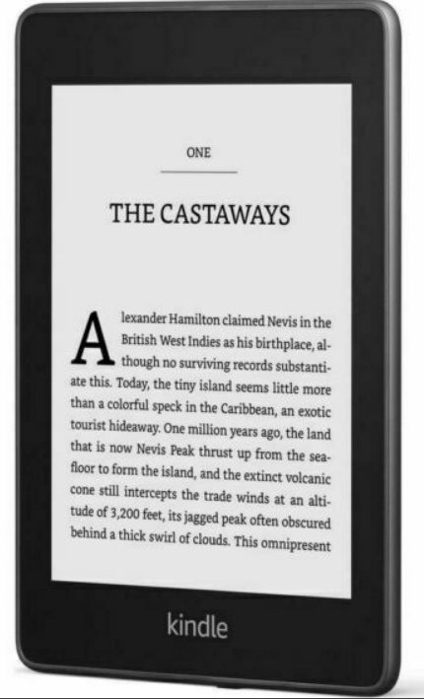

Idea
What do I like? May own user story
Read too many books, can’t remember what was the book about based on the title
Tried paper notes, paper diary, Instagram page – no success

Slide 3

Bookshelf the app
All books in one file
You can add or edit notes to the book
You can add or delete a book

Slide 4
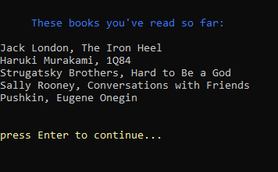
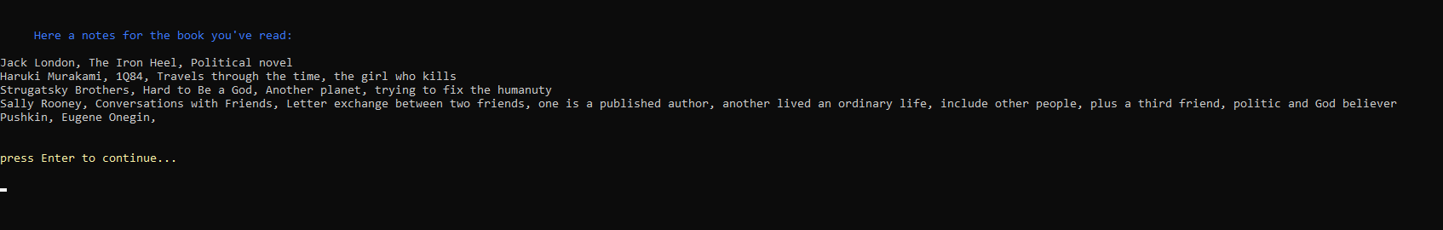
Open the library
With notes or without!

Slide 5
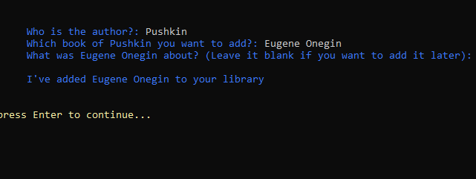
Add a book
You can add a note now or later!

Slide 6
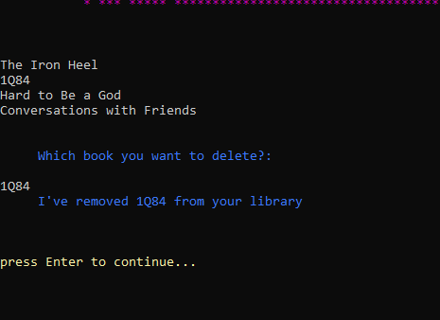
Delete the book
Do you want to delete the book? Whatever the reason is, you can do that!

Slide 7
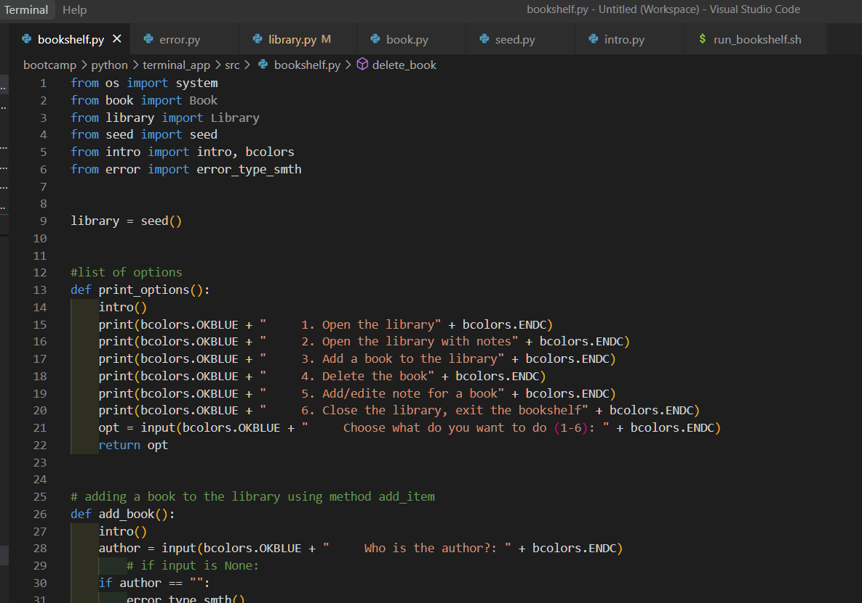
pages

Slide 8
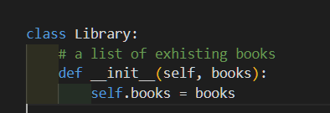
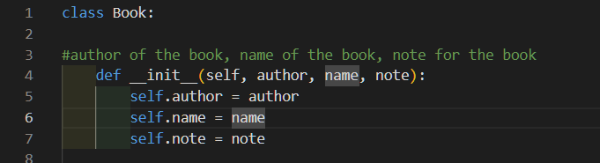
classes

Slide 9
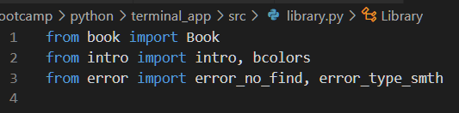
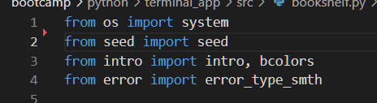
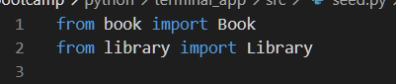
imports

Slide 10
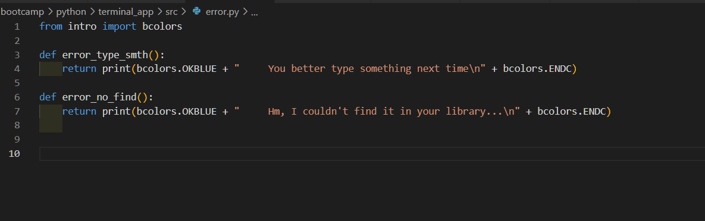
Error page

Slide 11
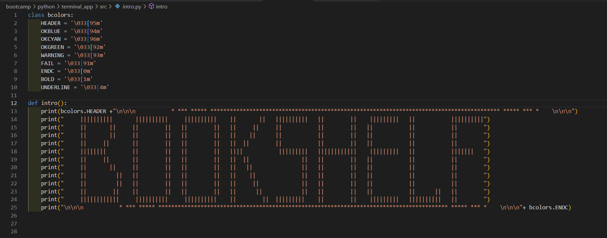
Art page

Slide 12
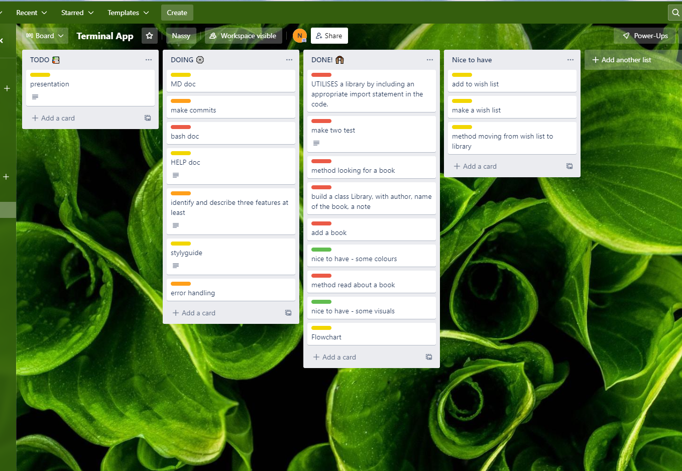
Trello board

Slide 13
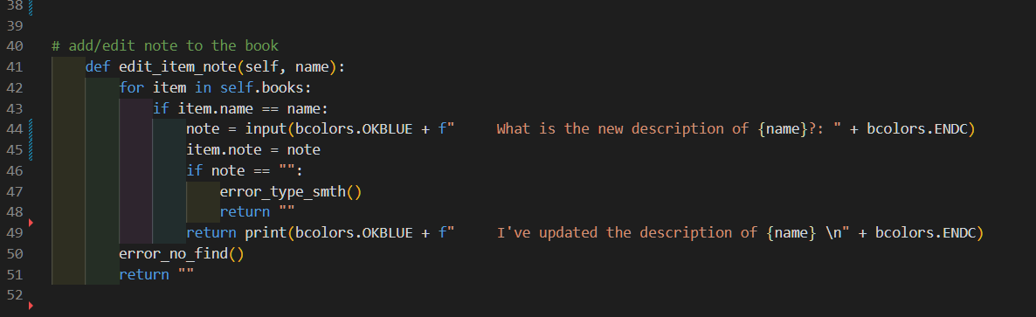
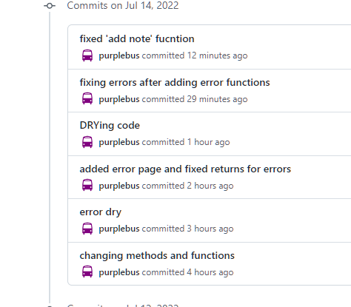
challenges

Slide 14
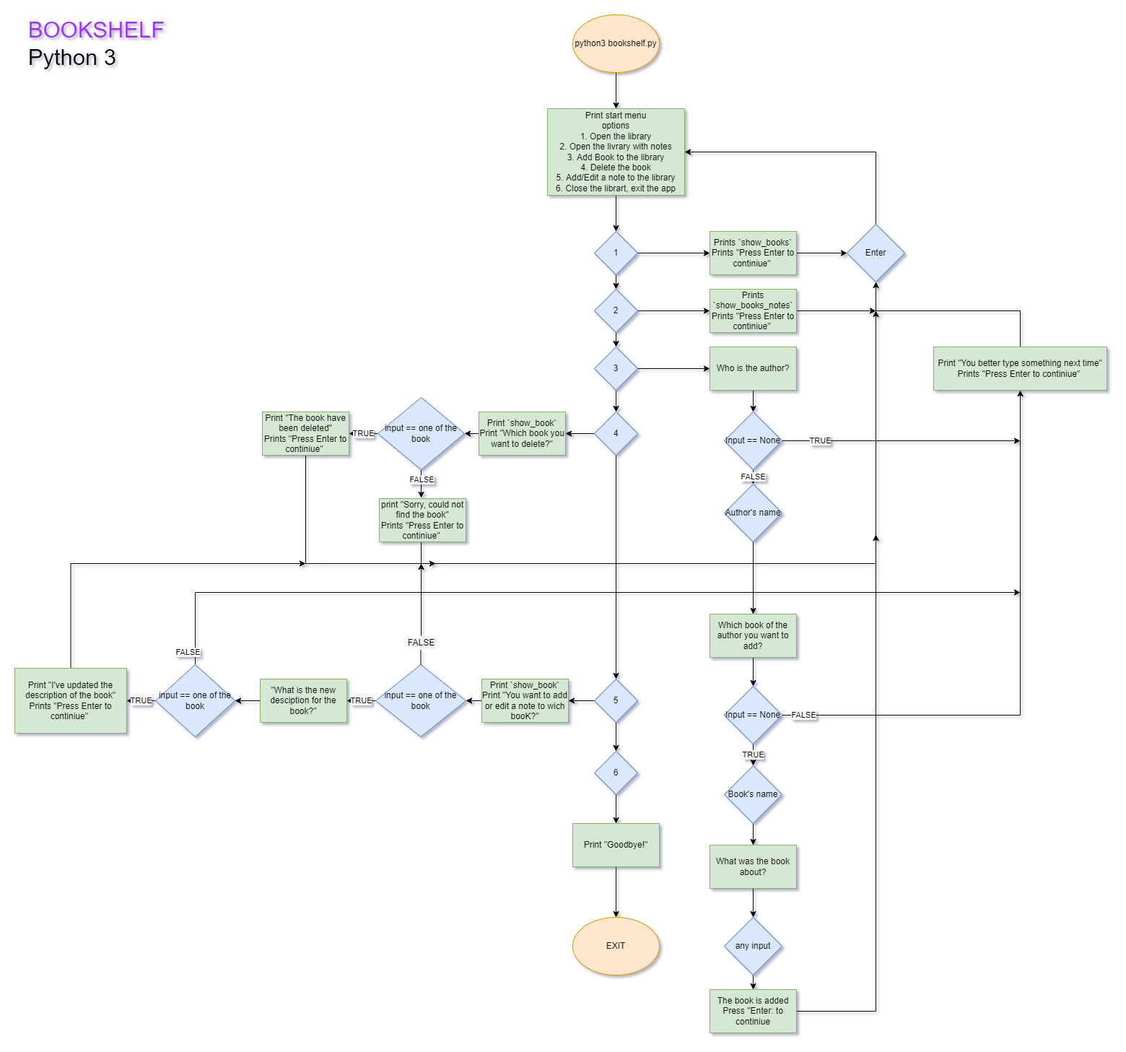
flowchart

Slide 15
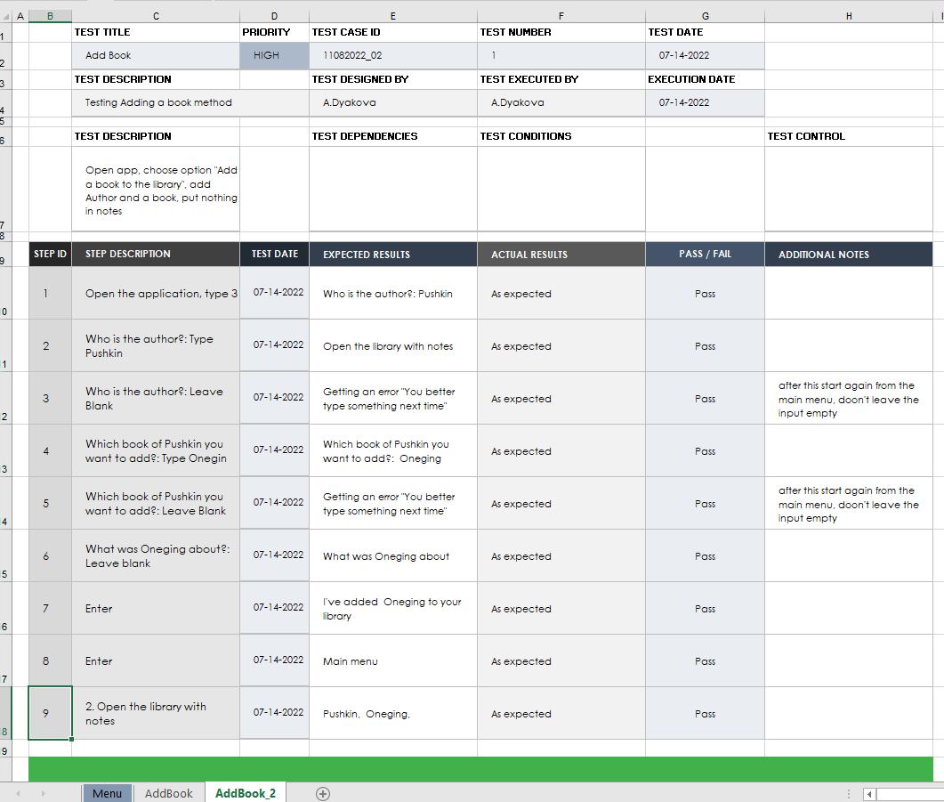
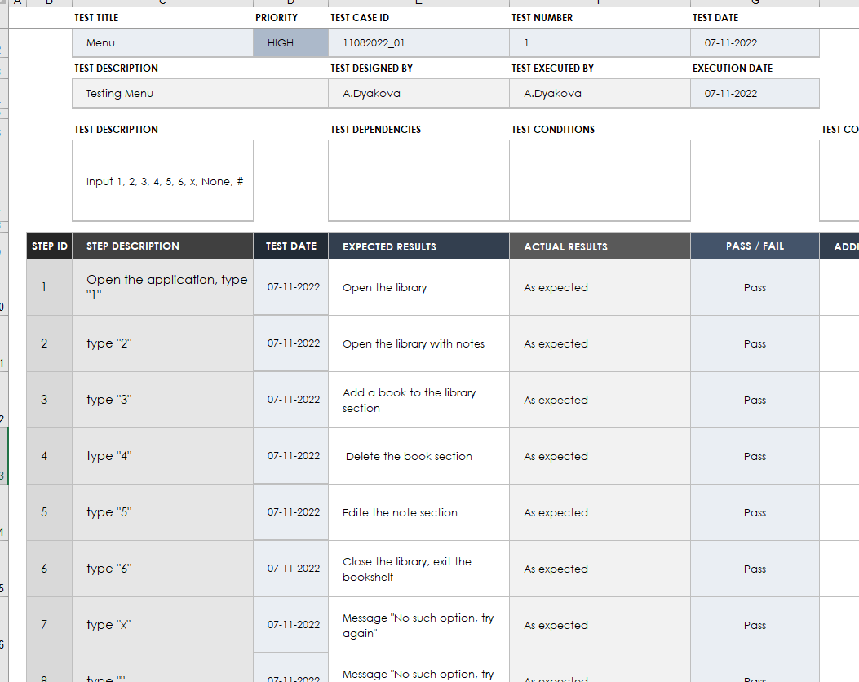
testing

Slide 16
recourses
Kindle Image https://i.ebayimg.com/images/g/Z2UAAOSwchNg3Hgk/s-l640.jpg
Library image https://www.weforum.org/platforms/centre-for-the-new-economy-and-society/articles/the-most-popular-us-library-books-of-2021

Slide 17
Thank you

